Slide 1

British Airways
Web Scrapping and Sentiment analysis

Slide 2
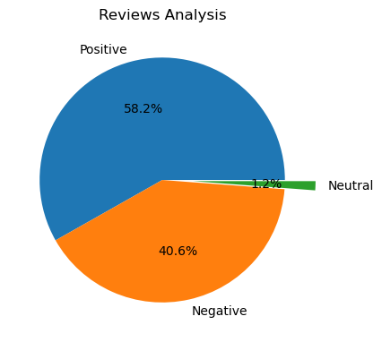
After cleaning the data
Sentiment analysis on 1000 reviews:
Positive: 582
Negative: 406
Neutral: 12

